Slide 1
Module-11: Part-3: BST – Insertion, Searching
CS 1714 – Computer Programming II

Slide 2
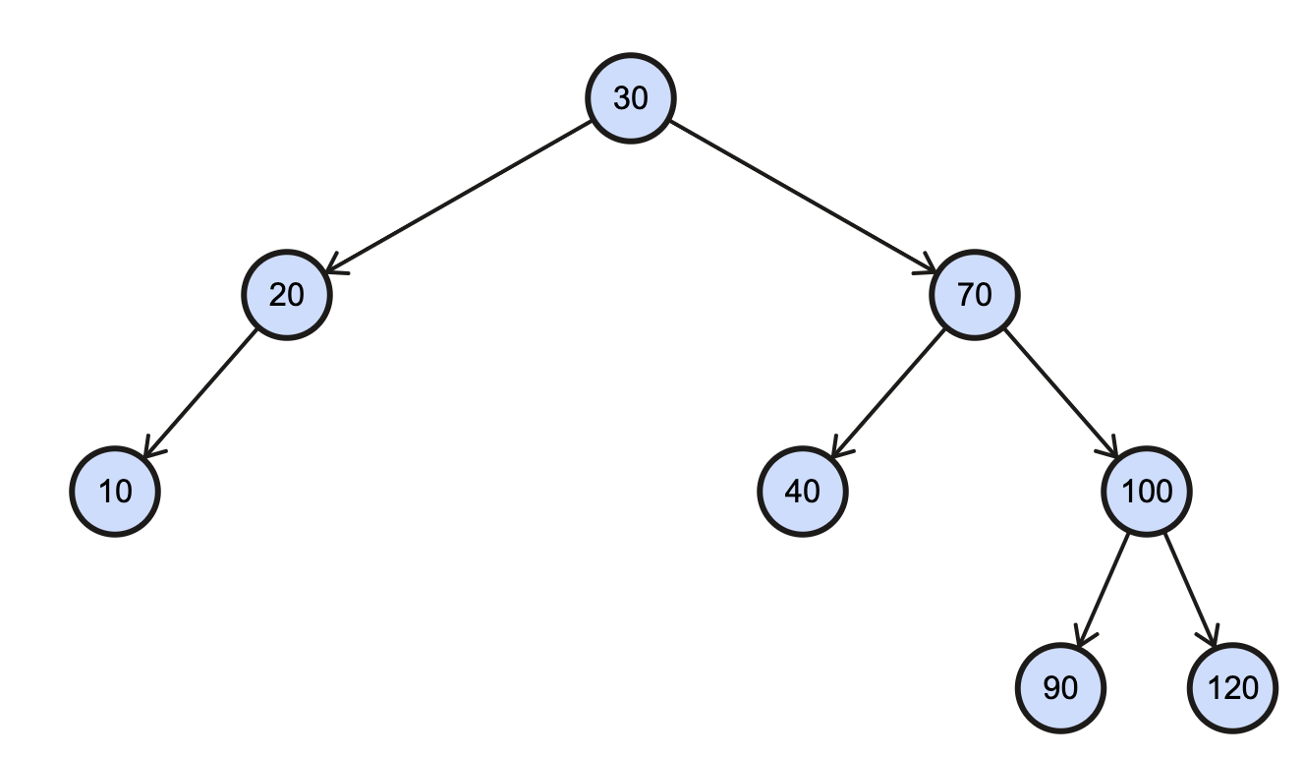
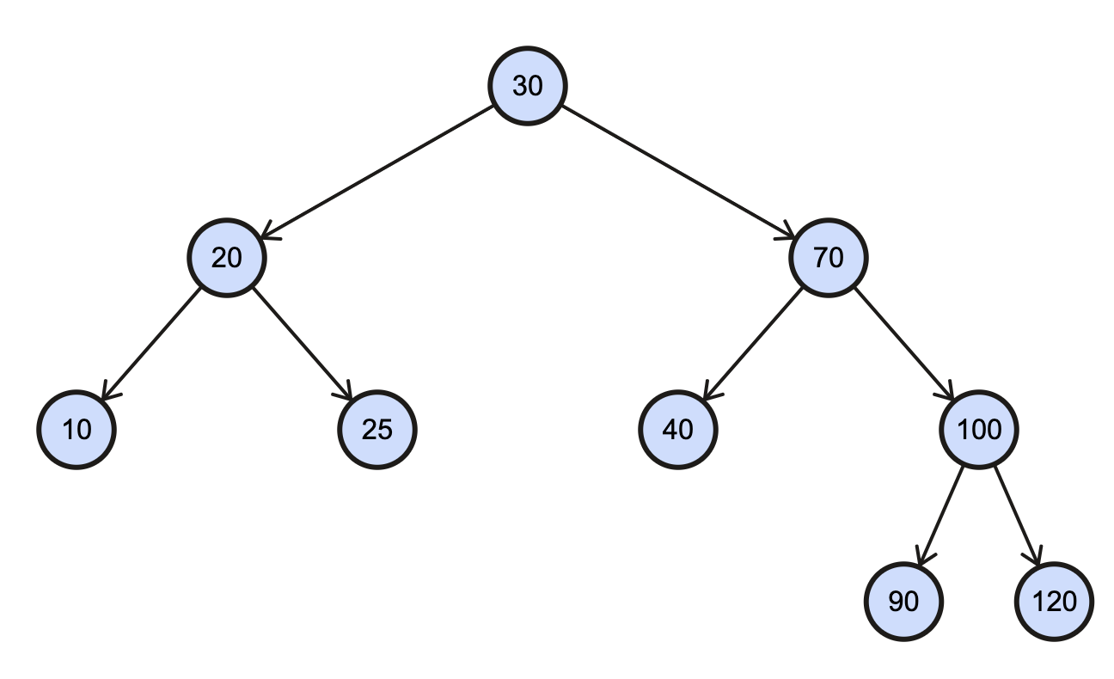
BST Insertion
To insert a new node into a BST, you have to find where it fits in the binary search tree in terms of the sorted order. That new node will become the left or right child of another node, depending on its value.
We will not rearrange nor replace nodes at insertion. Rather, we add the new node as a leaf to one of the bottom nodes that has room for a child.
INSERT -- 25

Slide 3
BST Insertion
BSTNode* insertNode(BSTNode* root, BSTNode* n)
{
if(root == NULL)
return n;
else if(root->val >= n->val)
root->left = insertNode(root->left, n);
else
root->right = insertNode(root->right, n);
return root;
}

Slide 4
BST Insertion
BSTNode* insertNode(BSTNode* root, BSTNode* n)
{
if(root == NULL)
return n;
else if(root->val >= n->val)
root->left = insertNode(root->left, n);
else
root->right = insertNode(root->right, n);
return root;
}
INSERT -- 25

Slide 5
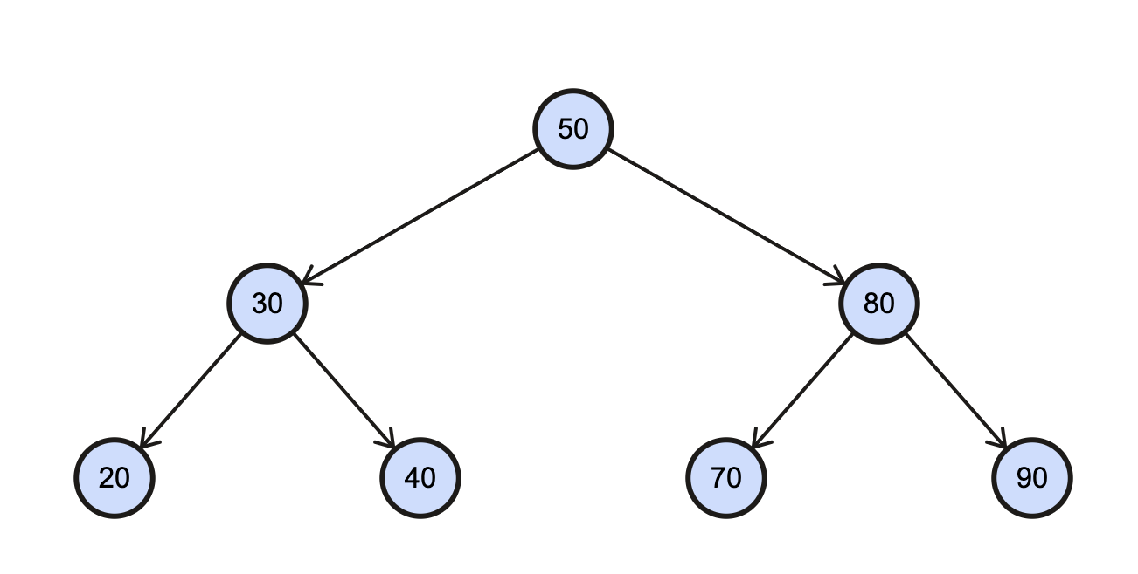
BST Searching
Searching a BST is looking for a key value in a specified data member of the BST node. Usually, this function returns a pointer to the node where it was found, NULL if it was not found. Searching for a value in a BST is faster than a linked list because of its sorted organization.
At each node, you can discard half the rest of the (sub) tree based on the comparison
Assume we are searching for 90: at the root, we already know that if the node exists, it will be in the right subtree.

Slide 6
BST Searching
BSTNode* search(BSTNode* root, int v)
{
if(root == NULL || root->val == v)
return root;
else if(root->val > v)
return search(root->left, v);
else
return search(root->right, v);
}
Searching is based on the standard traversal code.

Slide 7
BST Searching
BSTNode* search(BSTNode* root, int v)
{
if(root == NULL || root->val == v)
return root;
else if(root->val > v)
return search(root->left, v);
else
return search(root->right, v);
}
SEARCH -- 90

Slide 8
BST Searching
BSTNode* search(BSTNode* root, int v)
{
if(root == NULL || root->val == v)
return root;
else if(root->val > v)
return search(root->left, v);
else
return search(root->right, v);
}
SEARCH -- 50

